Slide 1


Slide 2
Higher and Degree apprenticeships
Notes:
My name is ‘insert name’ and I’m here on behalf of the Department for Education to talk to you about Higher & Degree apprenticeships.
Apprenticeships have really changed over the last few years. I think you are going to be surprised, and hopefully inspired, by the huge range of incredible opportunities now available to you through Higher & Degree apprenticeships.
Although some of you may already know what you’re planning to do when you leave school, it is important you listen carefully so that you can keep your options open should your plans change.
And for anyone who hasn’t quite decided what they want to do next when they leave school, I hope today will be really useful in helping you to understand your options.

Slide 3

Employed
Off the job
Intermediate – degree level
What are apprenticeships?
Paid a salary
Typically 1-6 years
Real responsibilities
600+ different apprenticeships
Contract
Not the easy option
Notes:
But before we look at Higher and Degree apprenticeships specifically, it’s important to cover what an apprenticeship actually is.
An apprenticeship is a real job, with a real employer, where the apprentice works full-time whilst also studying towards a qualification.
So you could be an apprentice working for Sky as a journalist, for example, whilst also studying and gaining a qualification in journalism.
PAID A SALARY
As it’s a real job, you will earn a wage – and it can be a really good salary too! The salary of an apprentice can vary from employer to employer. Legally, an employer must pay an apprentice the National Minimum Wage for apprentices, which is currently £5.28 per hour. This is lower than the normal National Minimum Wage, but it recognises that some people will be going into their first job with little or no experience.
The good news is that lots of employers pay a lot more than the National Minimum Wage for apprentices, with some local employers offering starting salaries of £xx,xxx and other national employers even offering starting salaries over £15,000-£30,000.
Presenter note: Please include local example you are aware of.
I have pulled together some local vacancy information which I will show you shortly, so you can see some real examples of local and national apprenticeships available and see what types of salaries are being offered.
It’s important to remember that if you see an apprenticeship you’re interested in, don’t be put off by the pay if it’s low: there’s room for progression and working your way to the top of an organisation.
CONTRACT
You will also get a contract of employment, holiday pay, annual leave etc – exactly the same as any other member of staff.
STUDY AND WORK
The apprentice will spend the majority of their time ‘on-the-job’ (doing their role), and a minimum of at least 6 hours per week ‘off-the-job’, which means studying or working towards their qualification.
This study element (off-the-job) would takes place with a training provider, who will help them to achieve the qualifications and make sure they complete their apprenticeship.
Training providers could be colleges, universities or independent training provider organisations, who deliver the training/teaching element of the course.
The employer will also support the apprentice, helping them to gain qualifications and valuable new skills and experience. As well as their time, employers also pay the fees of the apprentice’s training, showing their investment in the apprentice’s development.
TYPICALLY 1 – 6 YEARS
An apprenticeship typically takes 1 to 4 years to complete (sometimes up to 6 for some areas like a Solicitor). As a minimum, all apprenticeships must last for a minimum of 12 months.
The total duration will depend on the delivery model that the employer selects (how the mixture of training and working is delivered), the level (which we will explain later) and the subject they are studying.
600+ STANDARDS and INTERMEDIATE – DEGREE LEVEL
There are more than 600 different apprenticeship standards covering many different levels of apprenticeships, from Level 2 (which is the equivalent of 5 GCSEs), all the way up to Level 7, which is the equivalent to master’s level. So you can actually work your way towards gaining a degree or masters through an apprenticeship. We will discuss this more shortly.
REAL JOB = RESPONSIBILITIES and NOT THE EASY OPTION
As I said before, it’s a real job and so it’s important to remember that apprenticeships aren’t the ‘easy option’. Holding down a full time job and studying takes a certain skill and commitment, and it won’t be right for everyone.

Slide 4
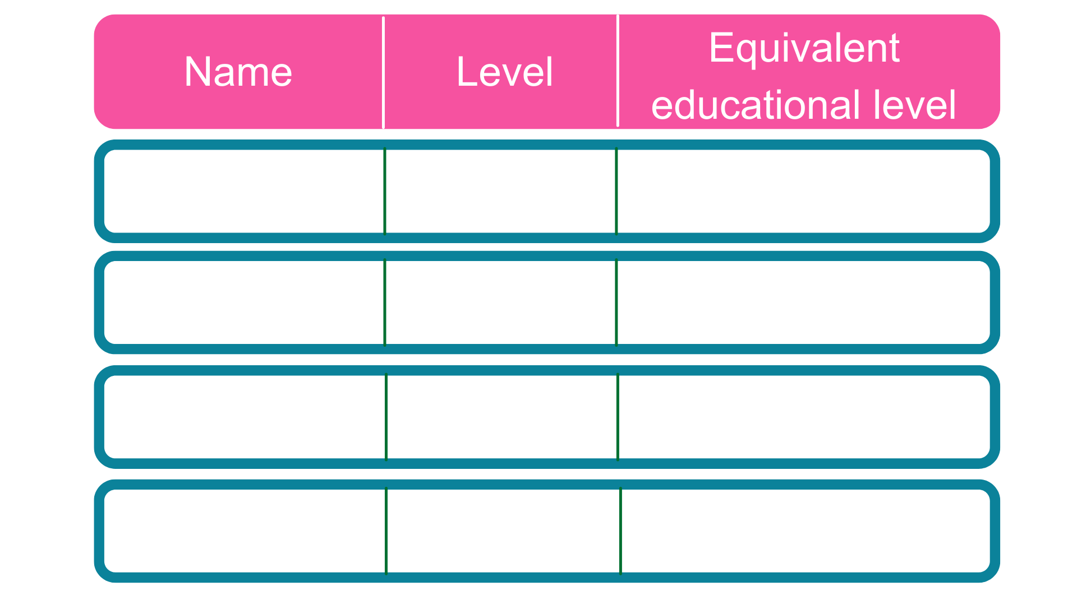
The levels of apprenticeships
Intermediate
2
5 GCSE passes at grade 4-9 (A*-C)
2 A Levels / Level 3 diploma / International Baccalaureate
Advanced
3
Higher
4,5,6 & 7
Foundation degree and above
Degree
6 & 7
Bachelor’s or master’s degree
Notes:
Each apprenticeship has a level which falls into one of the four categories above: Intermediate apprenticeships, Advanced apprenticeships, Higher apprenticeships and degree apprenticeships.
The equivalent educational level column helps to explain what level the qualification at the end of the apprenticeship will be in comparison to more familiar qualifications, like GCSEs and A Levels.
So you can see that if you do a level 3 (advanced) apprenticeship, once you have qualified you’ll have gained a qualification that is equivalent to 2 A Levels, a level 3 diploma or other equivalents, like IBs or BTECs.
You can now start an intermediate apprenticeship and work all the way up to achieving a degree or master’s through the apprenticeship route.
Higher apprenticeships cover all levels from 4 through to 7.
Level 4, 5, 6 and 7 are equivalent to a Foundation Degree and above.
A degree apprenticeship contains a Level 6 or 7 Bachelors or Masters degree or equivalent level 6 or level 7 qualification.
The level of apprenticeship you start at will depend on the kind of job that you are applying for.
It’s really important not to be held back by only looking for a particular level e.g. degree apprenticeships. Apprenticeships work a bit differently to school which can be confusing, as lots of students think that they should progress onto the next level, so if you leave after GCSEs you should do a Level 3 and if you finish after A Levels you should go for a degree apprenticeship, but this isn’t always the case.
Depending on the sector and apprenticeship, it may be that you need to start at advanced or higher level and work your way up, or that brilliant apprenticeships are only offered at certain levels – for example, Journalism is only offered at Level 5 because that is all the industry requires.
Equally, you may be entering a completely new sector or industry that you haven’t studied or worked in before, and so may need to do a Level 2 or 3 to enter the world of work and start at the correct level of understanding.
Doing a job is completely different to getting a GCSE or A Level and that’s why it can be a bit confusing.
It is very important to keep an open mind so that you can explore all of the opportunities available and have multiple options available when applying.
The duration of your apprenticeship will depend on a number of factors including the delivery model that your employer selects and which level of apprenticeship you are studying.
As a minimum, all apprenticeships must last for a minimum of 12 months.
Higher and Degree apprenticeships are more likely to last for 3 to 5 years. Some degree apprenticeships actually last for 6 years.

Slide 5
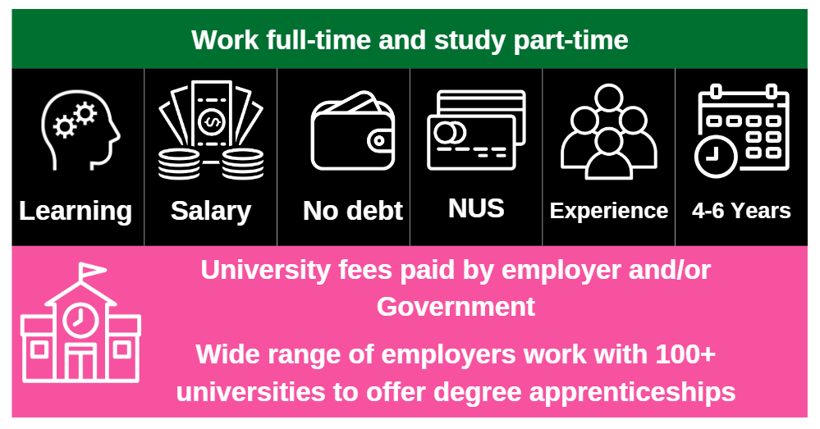
Higher and degree apprenticeships
Notes:
Higher and degree apprenticeships are a real alternative to following the traditional route of going to University as a full time student.
They offer all the benefits of higher education with none of the cost. You will not only be learning, but earning a salary, from day one. With a degree apprenticeship, you’re much less likely to build up any debt. Your tuition fees are paid for by your employer and the Government, so you will not be expected to pay £9000 a year.
More than 100 Universities in England offer degree apprenticeships now.
The students on degree apprenticeships are entitled to exactly the same benefits as other students, so you will still have access to the student union, sports facilities, clubs, societies and student discounts.
In the past, going to university was seen as the best way to advance your career to a higher level. But with the current level of competition for jobs among graduates, it might not be the best route for you. With an apprenticeship, you have the competitive advantage of gaining at least 3 years’ work experience whilst completing your degree.
You will study the same academic course content as if you were at university full time, but are able to put it into practice straight away in the workplace while also learning from colleagues and staying up to date on the latest trends and technology in the sector.
But remember – it’s hard work as a degree apprentice. You’ll be working full time and fitting in the equivalent of a full time degree alongside. It might take a bit longer than studying full time – for example, 4 years instead of 3, but you’ll achieve exactly the same degree.
No matter what kind of career you want to follow, you need to do your research and find out if there’s a way to get to the role you want through an apprenticeship. That way, you can decide if you would prefer to study full time at college or university, or if you would prefer to go into work as an apprentice and gain qualifications and experience on the job from day one.
Everyone has different learning styles and both routes offer a different way to learn and start your career. No route is better than the other, it is just about which is best/right for you.
Remember, you can apply for apprenticeships alongside applying for university and then you can decide what is right for you later on.

Slide 6












Aerospace engineer
Architect
Chartered legal executive
Dietitian
Degree apprenticeships available
Aerospace engineer
Doctor
Social worker
Storyboard artist
Solicitor
Project Manager
Senior Journalist
Marketing manager
First officer pilot
Notes:
There are now more than 240 different higher and degree apprenticeships available covering a huge range of job roles. Some of them are listed on this slide.
For example, you could become an architect or a solicitor.
You could also do an apprenticeship to become a town planner, a cyber security professional, an Ecologist, a Laboratory Scientist or even a Police Constable.
If you want to see the full latest list of apprenticeships, I would recommend that you visit ‘The Institute for Apprenticeships and Technical Education’ website / I have copies of the A-Z guide of apprenticeships.
This allows you to filter and see which apprenticeships are in development and at what stage of the approval process they are at. We will include a link to this website at the end of the presentation.
Suggested interactivity - engage the group in a discussion around these questions:
Are there any that surprise you?
Are there any that you’d look to like up now (using the IFATE website) to find out a little bit more about them and what they involve?
What other areas are you interested in? (Facilitate discussion around if apprenticeship opportunity available)

Slide 7




























Which employers offer apprenticeships?
Notes:
Presenter notes: Please update this slide with local companies if you feel that the logos are not representative of your area. Please include small and large organisations.
The range of employers offering apprenticeships is also incredible.
This slide shows you some really familiar logos of big companies in England who all recruit apprentices.
Some of these employers may not be recruiting currently, but you will be able to track their recruitment updates on their websites or social media.
Around 50% of apprenticeships started are with large companies like this, but 50% will be with smaller local companies.
It can be tempting to think that the ‘best’ apprenticeships are just with the big, well-known companies, but many of the smaller employers have absolutely brilliant schemes that enable fast-track career progression for their apprentices, so it’s really important to do your research and not to ignore smaller employers because they can be just as good.
Presenter notes: please include an example of a local company in the town that you are delivering in. An example of a small local company is…X who employs apprentices in job roles like X and X etc.

Slide 8
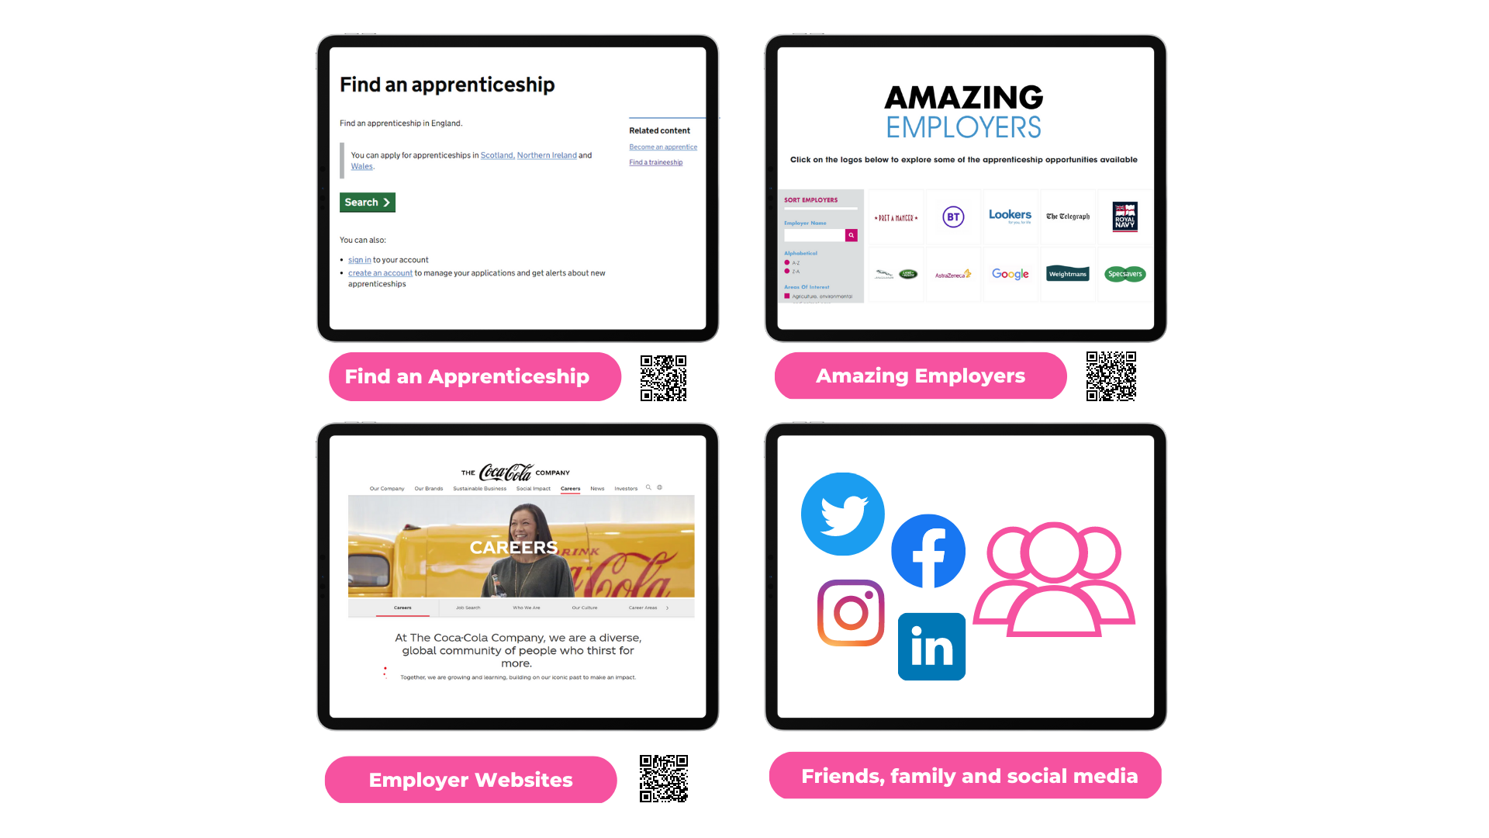
How to find a higher/degree apprenticeship
Notes:
What is the application process and where do you start?
As apprenticeships are real jobs, there is not just one system to find them like the standard UCAS format for full-time university.
There are various platforms now that you can use to help streamline some of this searching.
Find an apprenticeship is the government search portal for live apprenticeships. It’s a huge job posting of apprenticeship vacancies that are being advertised now (today) and features all levels; Intermediate, Advanced and Higher & Degree. You can register and set up alerts to tell you when the types of apprenticeships you’re looking for go online and you can also apply directly to the employer.
UCAS has a dedicated apprenticeships page on their website and you can now apply for degree apprenticeships through UCAS. A great benefit is that, if you’re still not sure which direction you would like to take, applying for an apprenticeship does not usually take away from your 5 options. You can still apply for 5 full-time University choices, as well as many degree apprenticeships as you like. Then when you get to the summer and see what offers come back, you are in a much better position to make a decision based on lots of offers.
Employer websites are also a hugely important source as many employers will advertise their vacancies directly, particularly for their Higher and Degree schemes which may have a more rigorous application process. Make sure to follow their social media accounts and set up any alerts that you can to find out about their vacancies and when they’re recruiting.
The Higher & Degree vacancy listing is also a really useful document that is shared in November and then an updated version is released again in February. This contains a list of hundreds of higher and degree apprenticeship vacancies that are open for application, and gives key information about the employer, the apprenticeship, the salary, location and where to apply. This will be shared on the Amazing Apprenticeships website and apprenticeships.gov.uk.
Additionally, we have spoken to lots of apprentices and quite often, they will say that they actually heard about their job through a family member or friend. So make sure you tell everyone you can think of that you’re looking for an apprenticeship and you never know what might come through!
There are lots of other job search sites out there, as well as sites you can find further information, such as:
Amazing Apprenticeships website to get information on new vacancies and for employer area
Local LEP opportunities portals (if applicable)
Local websites (Presenter to add)
Definitely spend some time looking into the different types of employers. There will be a real mix from your local council who might have a jobs page for young people, through to bigger recruitment sites too.

Slide 9
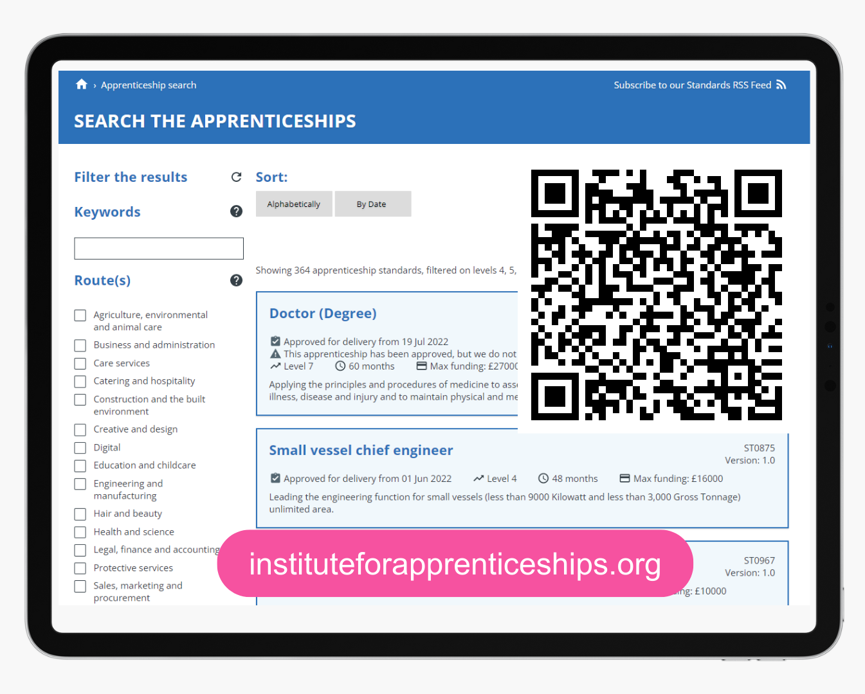
Institute for Apprenticeships and Technical Education
Notes:
I also mentioned earlier that I would share the link to the IFATE website where you can see a full list of the different higher and degree apprenticeships available.
The link is available on the screen here. I will also share the links with your teacher after this session.

Slide 10
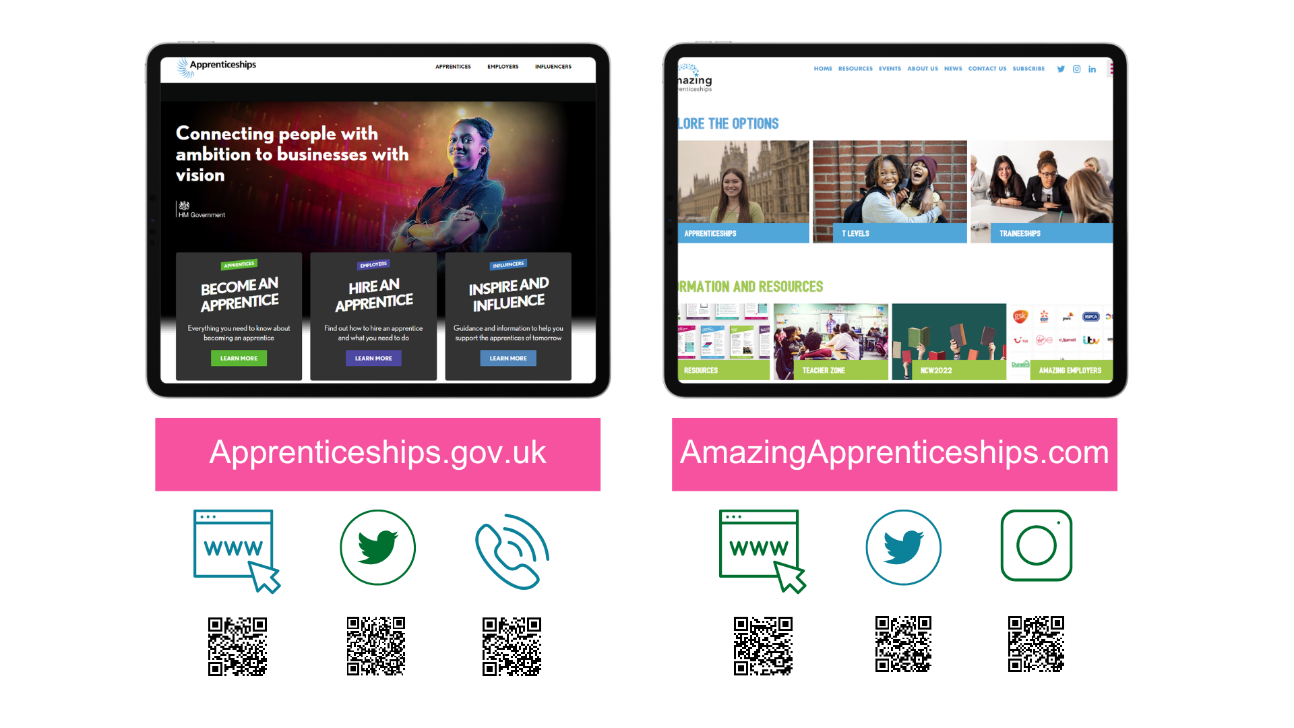
amazing
Notes:
Thank you so much for listening today, it has been an absolute pleasure meeting and talking to you all.
I hope that you have found today useful.
Remember, there is lots of support out there to help to guide you into the right choice for you after this session.
You can speak to your teachers here at school who can point you in the direction of the Careers Leader who will be able to tell you more about degree apprenticeships. They are also in touch with us and so we can answer your questions/come back in and run further sessions if lots of people still want further help.
There is also lots of support and information out there to help you to stay up to date with the latest apprenticeships information.
Visit www.apprenticeships.gov.uk for more information on apprenticeships and resources to help you to search for and apply for apprenticeships.
You can also follow @apprenticeships on social media for apprenticeship updates or get in touch with the details on the slide.
To find more films, apprentice stories or learn more about apprenticeships or T Levels, you can also go to www.amazingapprenticeships.com/student-zone.
You can also contact the National Careers Service, who as we said, can help to give you advice and guidance.

Slide 11
How to choose and apply to the right University and course
Rob Rattray

Slide 12
Terminology
UCAS
Undergraduate/ Foundation
Integrated Masters
Sandwich
Validation
Accreditation
Russell Group
Conservatoires
Research Intensive
Post-92/ New
Newer
Private
F.E. Colleges

Slide 13
The UCAS form - deadlines
Music and some Conservatoires – 1st October
Oxbridge/ Medicine/ Veterinary Medicine/ Dentistry – 15th October
Majority of courses – 30th January
Final decisions from HEI’s – 2nd May
A level Results Day – 14th August

Slide 14
The UCAS form
Personal details
Choices
Qualifications
Personal Statement
Reference

Slide 15
Choices
5 options
50,000 different undergraduate degrees
395 institutions
Grades/ Points
Contextual offers
Courses – BA/BSc/BMus/BEng/MSc/MEng
Accreditation – BPS/ ACCA etc

Slide 16
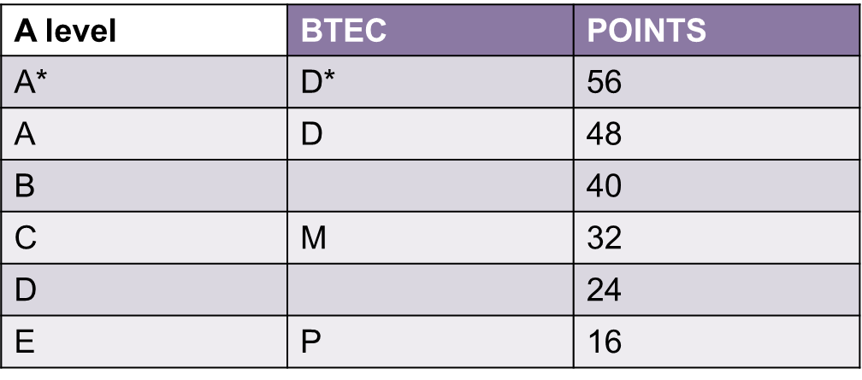
Grades and Points

Slide 17
Choosing…
Course
Location
Size
Cohort
League tables
TEF
Research
Deferred entry
Modern Culture
Media Studies
Comfortable Subjects
Uncertainty of choices

Slide 18
Non-traditional/ Vocational
Digital Security
Landscape Architecture and Design
Data Science
Child Development and Playwork
Events Management
Sports Business Management

Slide 19
Personal Statement
Why do you want to do this course?
How have you selected these courses?
What do you hope to gain from this course?
Do you have career aspirations?
Do you have the relevant experience?
What are your interests?
What makes you interesting?
Volunteering
Work experience
Hobbies

Slide 20
The university response
Unconditional
Conditional – grades/ interview/audition
Unsuccessful
Extra

Slide 21
The applicant response
Firm
Insurance
Decline

Slide 22
The Mantlepiece factor
X factor vs Meh factor
Be prepared to rule things ‘out’, before you can rule things ‘in’
Do attend open days
Spend time with support services
Explore accommodation options from Year 2 onwards.....
Do not go on holiday on Post-16 results day
Manage drop out ‘hot spots’
Work on life skills and budgeting
The Study Skills Handbook – Dr Stella Cottrell
(Palgrave Study Skills)

Slide 23
R.Rattray@leedsbeckett.ac.uk

Slide 24


